Slide 1

332:479 Concepts in VLSI
Design
Lecture 16
Adders
David Harris
Harvey Mudd College
Spring 2004

Slide 2
Outline
Single-bit Addition
Carry-Ripple Adder
Carry-Lookahead Adder
Carry-Select Adder
Summary
Material from: CMOS VLSI Design,
by Weste and Harris, Addison-Wesley, 2005

Slide 3
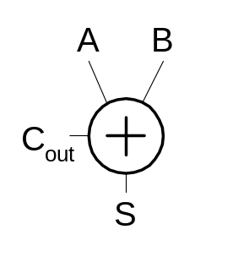
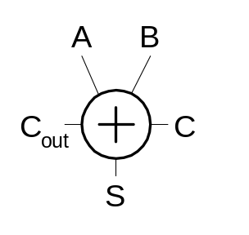
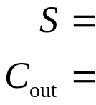

Single-Bit Addition
Half Adder Full Adder
A | B | C_{out} | S
0 | 0
0 | 1
1 | 0
1 | 1
A | B | C | C_{out} | S
0 | 0 | 0
0 | 0 | 1
0 | 1 | 0
0 | 1 | 1
1 | 0 | 0
1 | 0 | 1
1 | 1 | 0
1 | 1 | 1

Slide 4
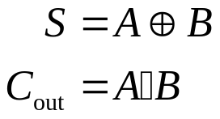
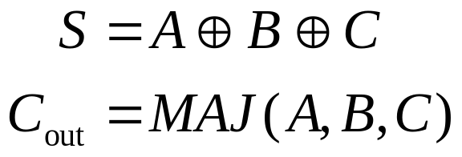
Single-Bit Addition
Half Adder Full Adder
A | B | C_{out} | S
0 | 0 | 0 | 0
0 | 1 | 0 | 1
1 | 0 | 0 | 1
1 | 1 | 1 | 0
A | B | C | C_{out} | S
0 | 0 | 0 | 0 | 0
0 | 0 | 1 | 0 | 1
0 | 1 | 0 | 0 | 1
0 | 1 | 1 | 1 | 0
1 | 0 | 0 | 0 | 1
1 | 0 | 1 | 1 | 0
1 | 1 | 0 | 1 | 0
1 | 1 | 1 | 1 | 1

Slide 5
PGK
For a full adder, define what happens to carries
  Generate: C_{out} = 1 independent of C
    G =
  Propagate: C_{out} = C
    P =
  Kill: C_{out} = 0 independent of C
    K =

Slide 6
PGK
For a full adder, define what happens to carries
  Generate: C_{out} = 1 independent of C
    G = A • B
  Propagate: C_{out} = C
    P = A ⊕ B
  Kill: C_{out} = 0 independent of C
    K = ~A • ~B

Slide 7
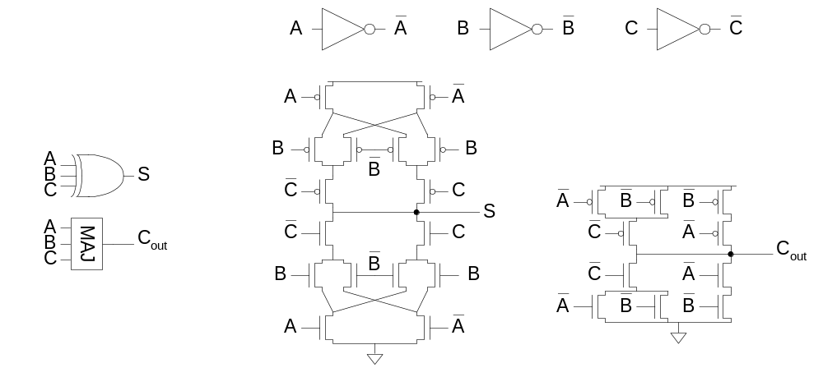
Full Adder Design I
Brute force implementation from eqns.

Slide 8
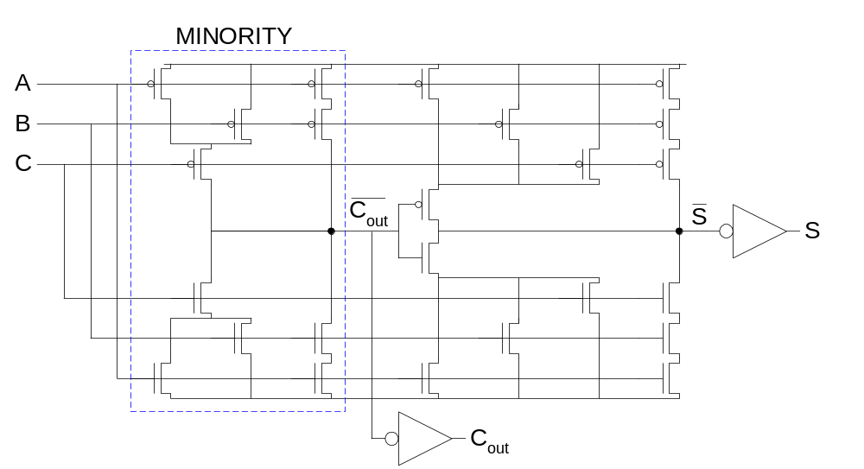
Full Adder Design II
Factor S in terms of C_{out}
S = ABC + (A + B + C)(~C_{out})
Critical path is usually C to C_{out} in ripple adder

Slide 9
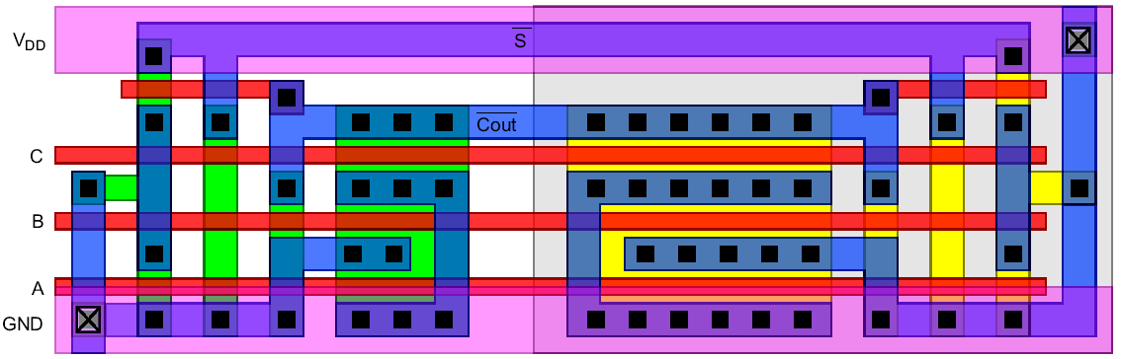
Layout
Clever layout circumvents usual line of diffusion
  Use wide transistors on critical path
  Eliminate output inverters

Slide 10
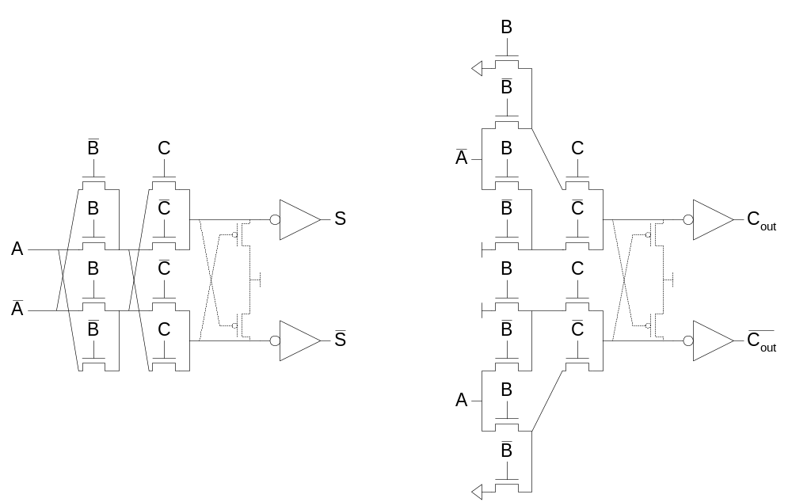
Full Adder Design III
Complementary Pass Transistor Logic (CPL)
  Slightly faster, but more area

Slide 11
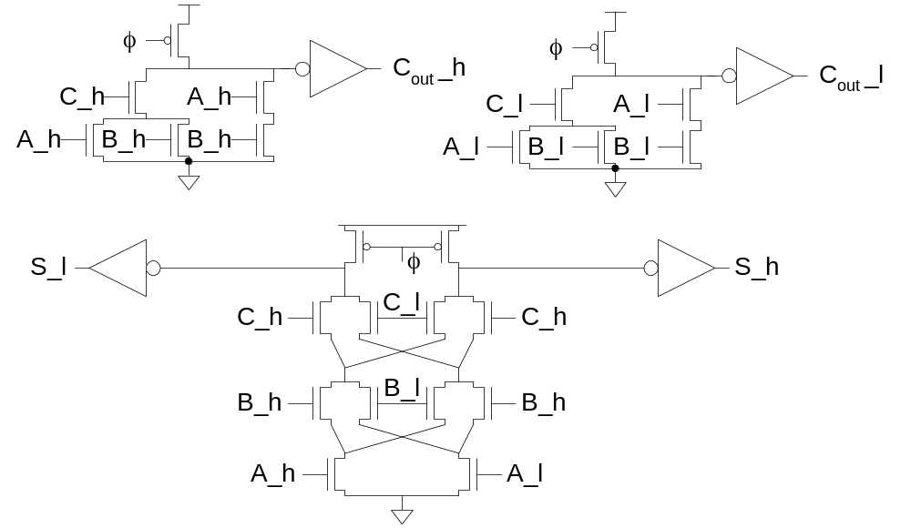
Full Adder Design IV
Dual-rail domino
  Very fast, but large and power hungry
  Used in very fast multipliers

Slide 12
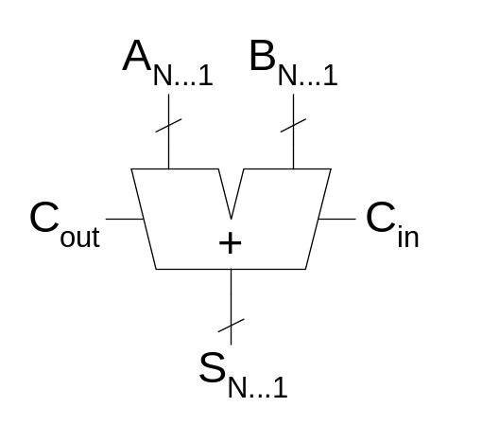
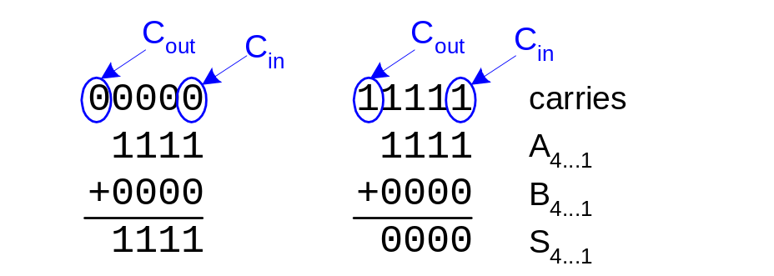
Carry Propagate Adders
N-bit adder called CPA
  Each sum bit depends on all previous carries
  How do we compute all these carries quickly?

Slide 13
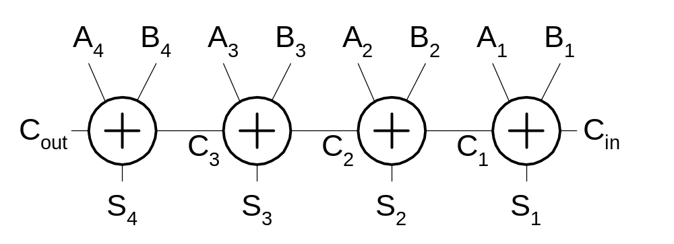
Carry-Ripple Adder
Simplest design: cascade full adders
  Critical path goes from Cin to Cout
  Design full adder to have fast carry delay

Slide 14
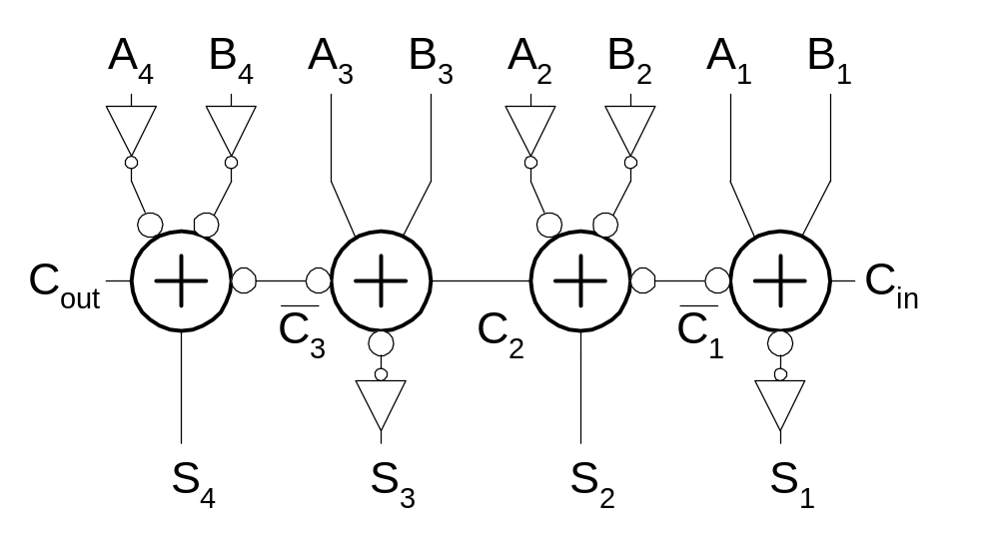
Inversions
Critical path passes through majority gate
  Built from minority + inverter
  Eliminate inverter and use inverting full adder

Slide 15
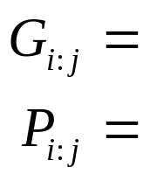
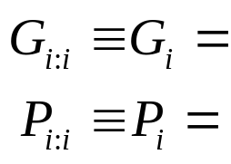
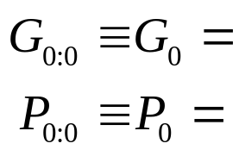

Generate / Propagate
Equations often factored into G and P
Generate and propagate for groups spanning i:j
Base case
Sum:

Slide 16
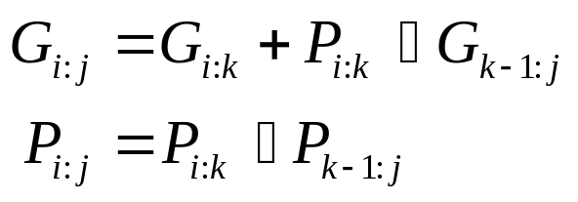
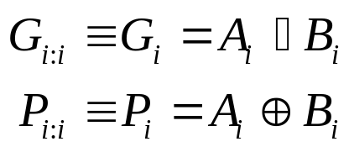
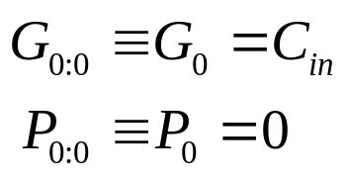

Generate / Propagate
Equations often factored into G and P
Generate and propagate for groups spanning i:j
Base case
Sum:

Slide 17
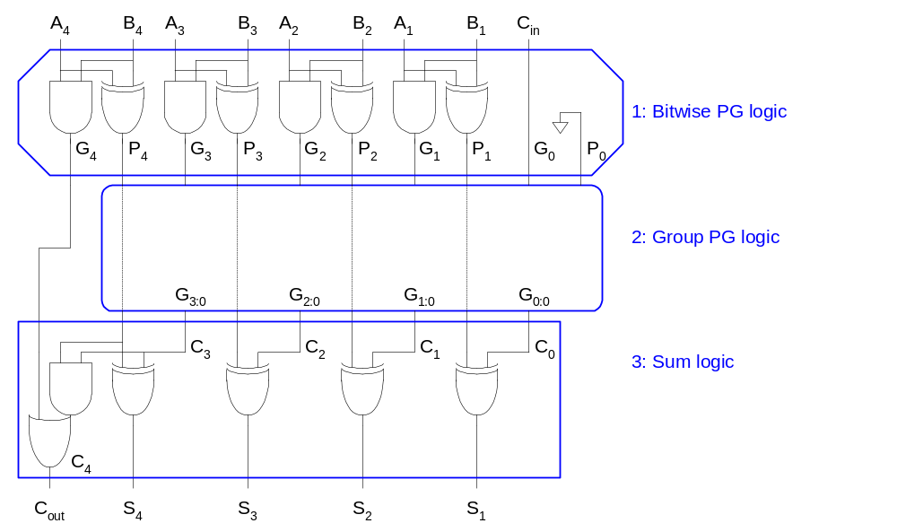
PG Logic

Slide 18
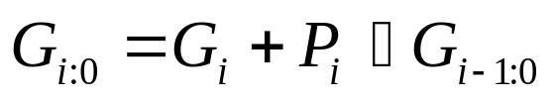
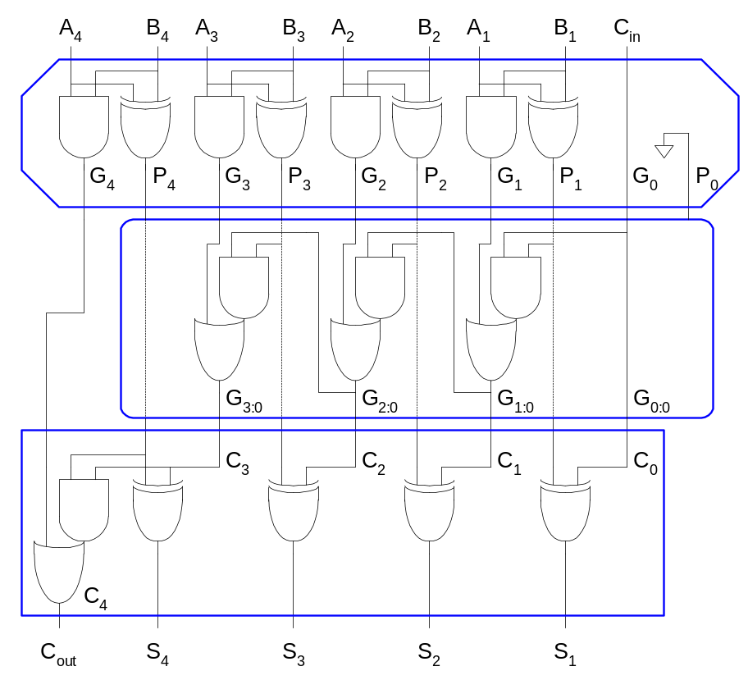
Carry-Ripple Revisited

Slide 19
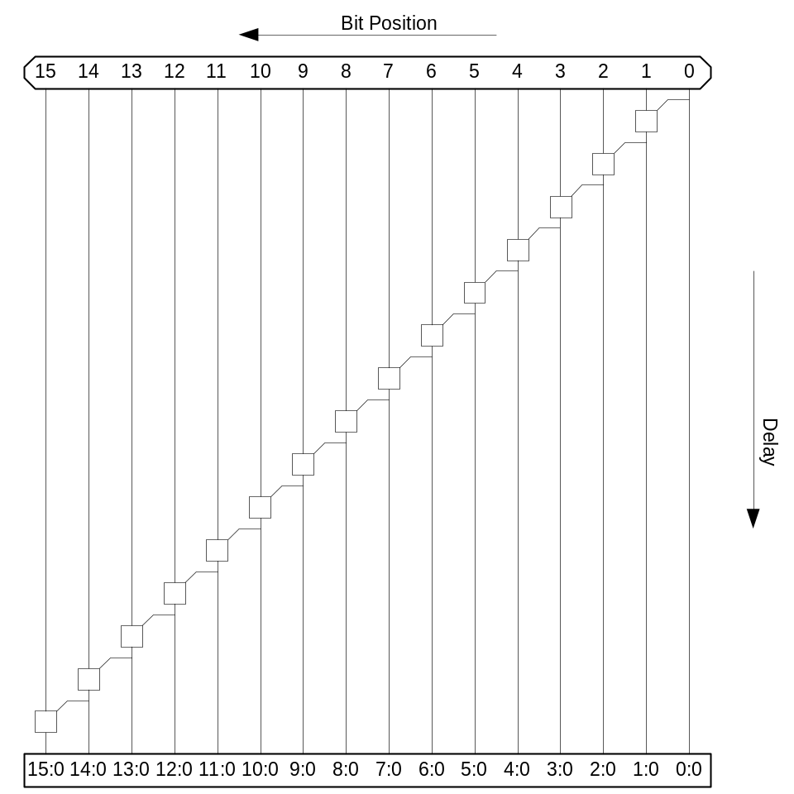

Carry-Ripple PG Diagram

Slide 20

Carry-Ripple PG Diagram

Slide 21
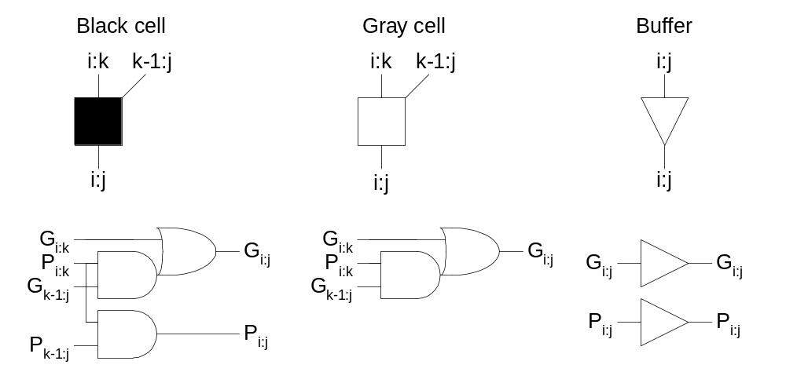
PG Diagram Notation

Slide 22
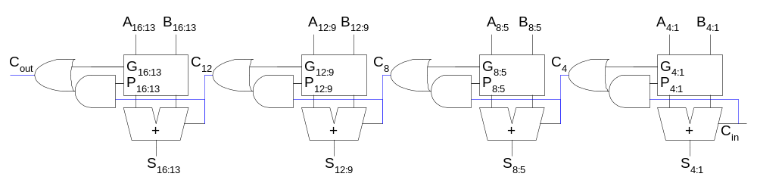
Carry-Lookahead Adder
Carry-lookahead adder computes G_{i:0} for many bits in parallel.
Uses higher-valency cells with more than two inputs.

Slide 23
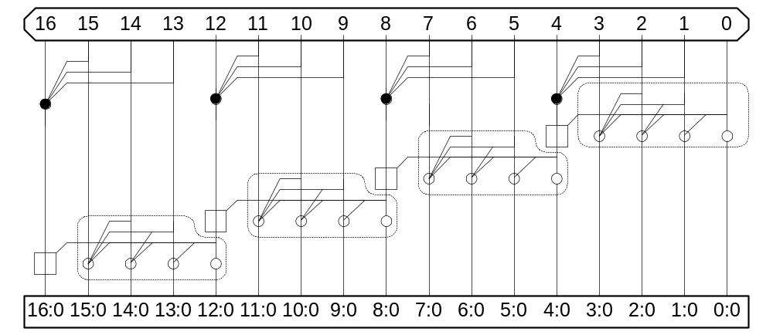
CLA PG Diagram

Slide 24
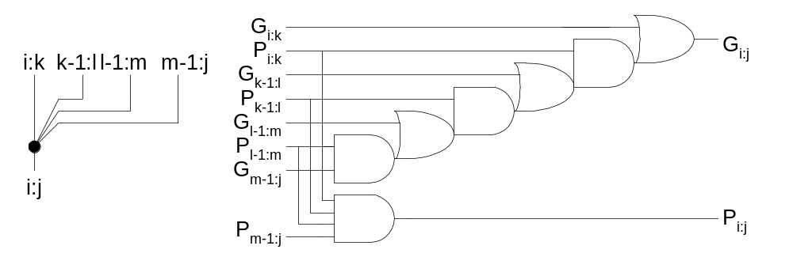
Higher-Valency Cells

Slide 25
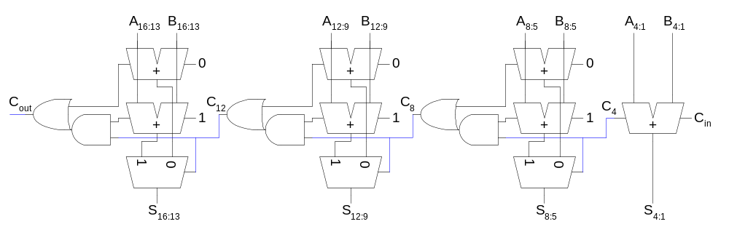
Carry-Select Adder
Trick for critical paths dependent on late input X
  Precompute two possible outputs for X = 0, 1
  Select proper output when X arrives
Carry-select adder precomputes n-bit sums
  For both possible carries into n-bit group

Slide 26
Summary
Adder architectures offer area / power / delay tradeoffs.
Choose the best one for your application.
Architecture | Classification | Logic Levels | Max Fanout | Tracks | Cells
Carry-Ripple |  | N-1 | 1 | 1 | N

